Slide 1
Ray’s Rentals
Submission presentation
By: Faran Azadi, aamer atique, naim ahmed, yusof bandar, Pritam sangani

Slide 2
Introduction to the Scenario
Summarize the key product, service, technology, concept, or strategy on which your business is based.
Notes:
Introduces what ray’s rentals is and current paper-based system

Slide 3
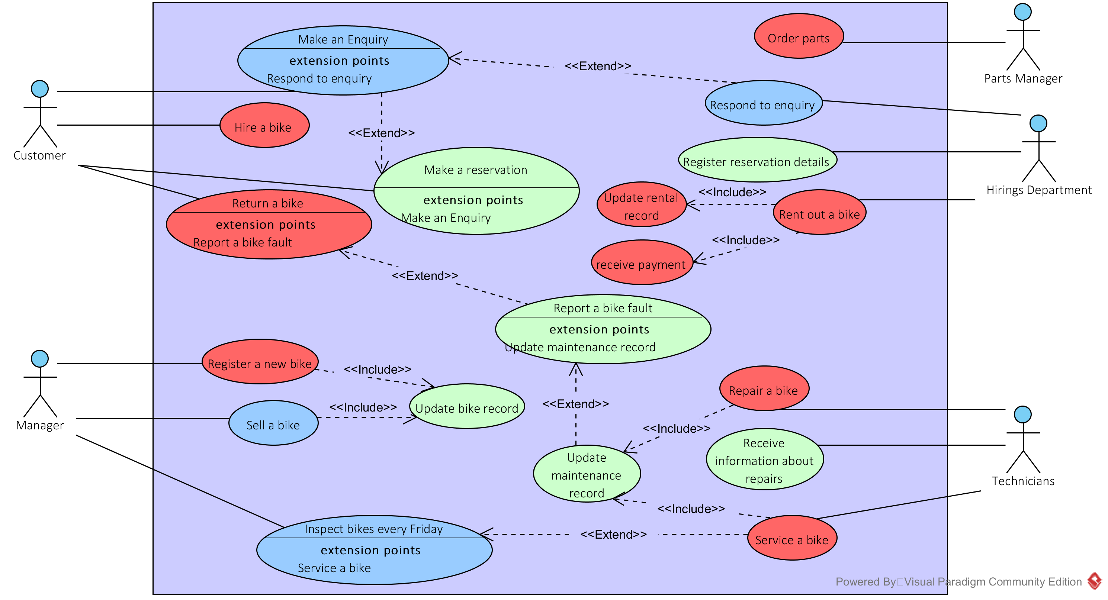
Group Use Case Diagram
Notes:
Brief overview of use case diagram and give descriptions and justifications of all priorities

Slide 4
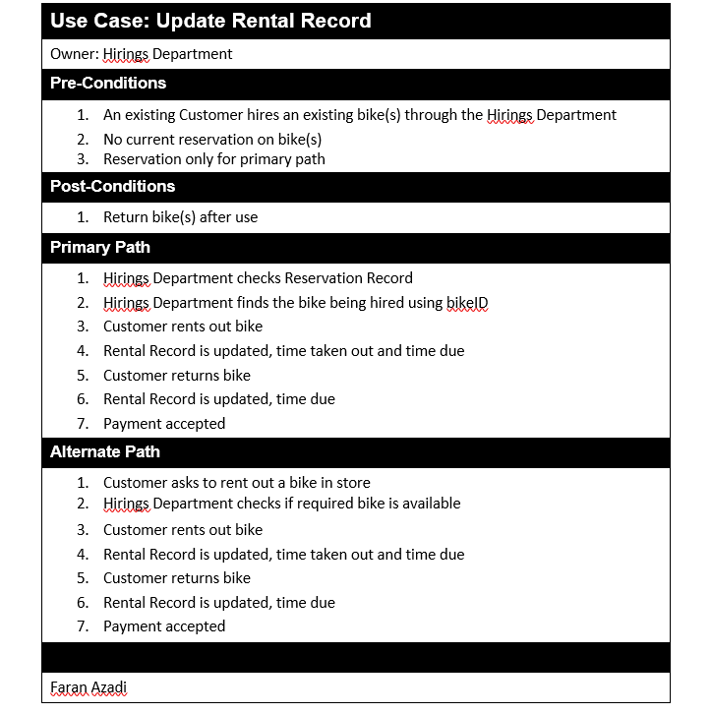




Use Case Specifications
Notes:
Describe the core use case specifications

Slide 5
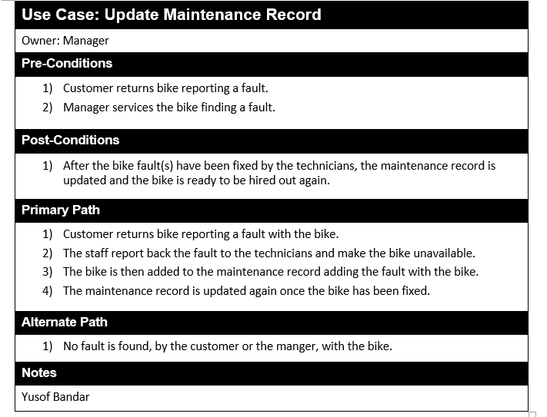
Use Case Specifications continued…
Notes:
Describe the core use case specifications

Slide 6
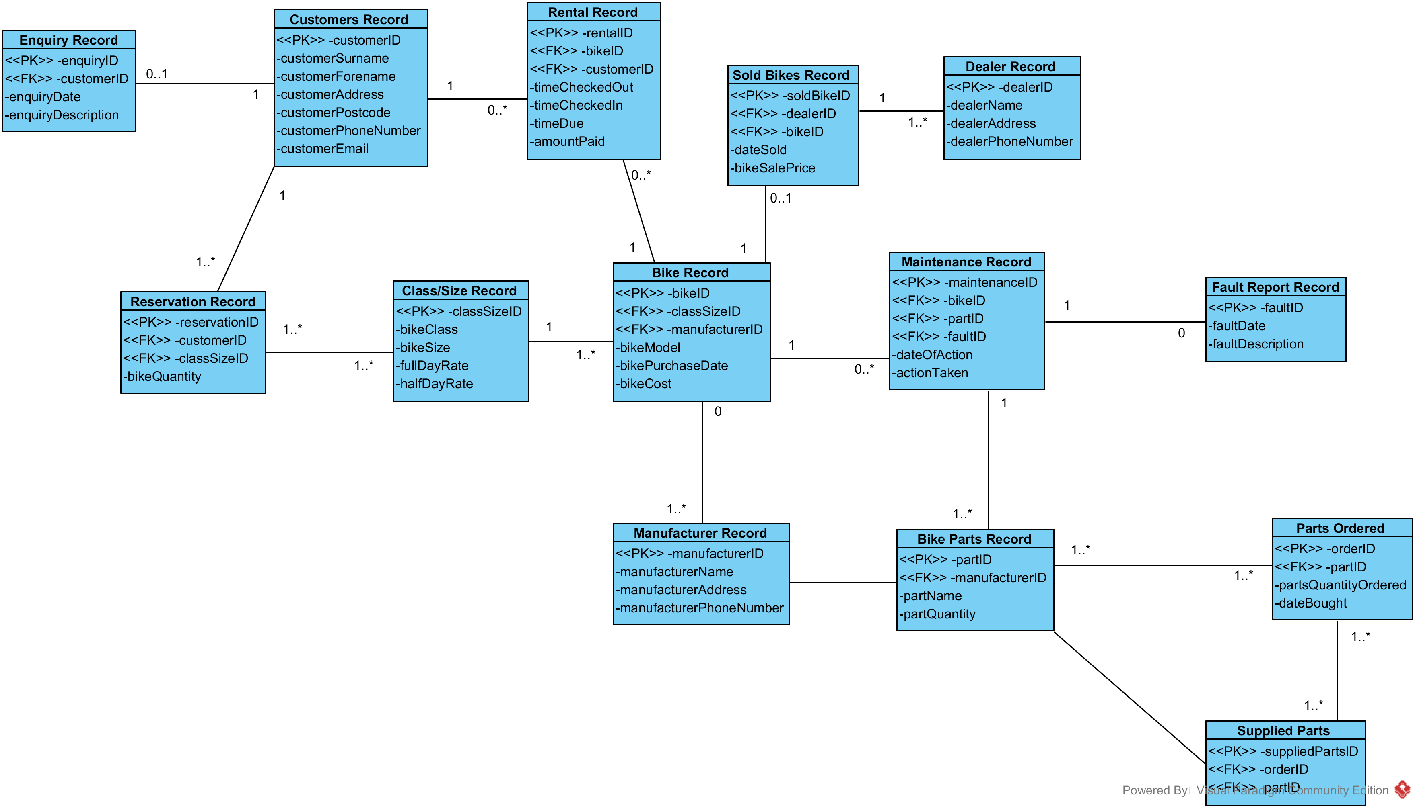
Group Entity Relationship Diagram
Notes:
Brief overview of ERD

Slide 7
ORACLE System
Now we will demonstrate our ORACLE System running as well as our queries.
Notes:
Give demonstration of working SQL and Queries

Slide 8
Conclusion
Summarize the competition.
Outline your company’s competitive advantage.
Notes:
Close off presentation with brief closing statement

